Slide 1

Interagency EV Working Group
Year in Review
December 1, 2023

Slide 2
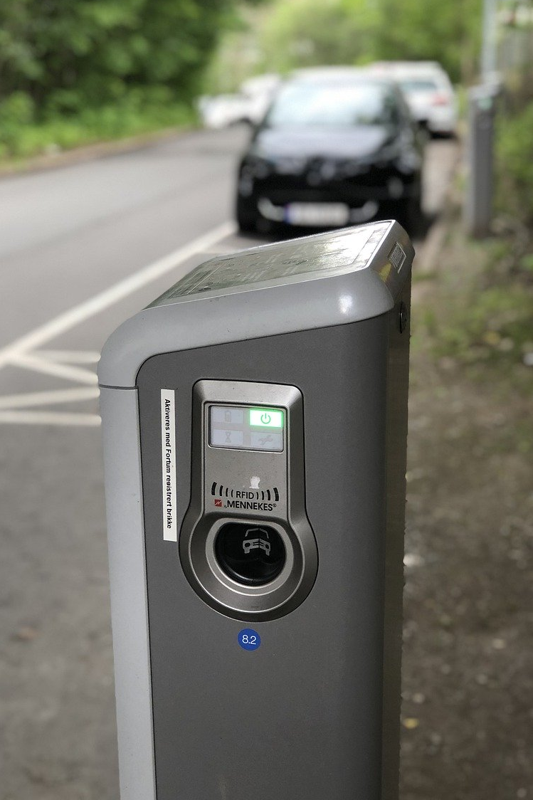
Agenda
01 Year in Review - Overview
02 Key Takeaways
02.1 State Agency Coordination
02.2 Public Engagement - Stakeholders
02.3 Contracting
02.4 Electric Utility Providers
02.5 Industry Association
02.6 Academia
02.7 Equity Considerations
02.8 Labor and Workforce Considerations
02.9 Cybersecurity & Communications
03 Consultant assistance with the NEVI Formula Plan
04 Recap of Plan Vision and Goals
05 Moving Forward into 2024
06 Conclusion & Q/A

Slide 3
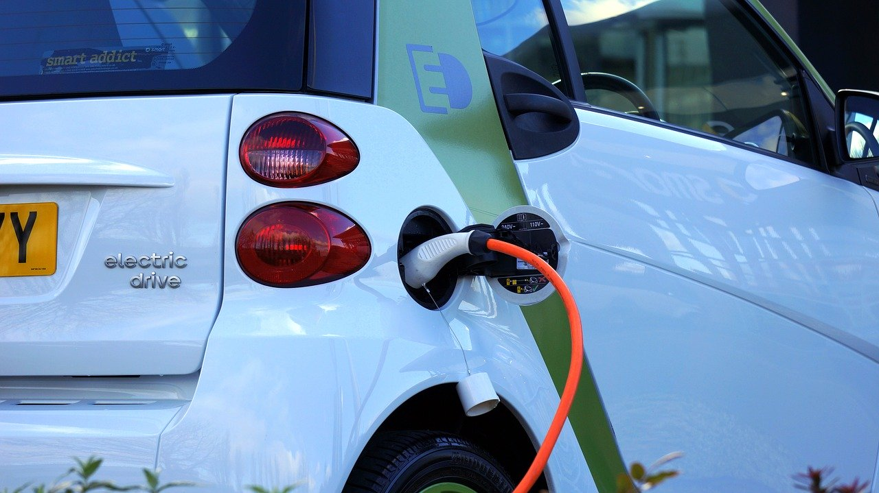
01
Year in review - Overview
Interagency EV Working Group
convened as part of Executive Order
2022-31
Establishment of the SCDOT NEVI Plan
Interaction with 29 different
Speakers over 11 monthly meetings
Consultant Assistance with South
Carolina’s Implementation of the NEVI Formula Program

Slide 4

02
Key Takeaways
02.1 State Agency Coordination
The Interagency EV Working Group was established to ensure cohesion with state agencies, industry partners, utility companies, and community stakeholders to streamline the deployment of electric vehicle infrastructure, analyze regulatory frameworks, and support workforce development in South Carolina.
Throughout the year, the working group has expanded our knowledge base via collaborative efforts among multiple state agencies.

Slide 5
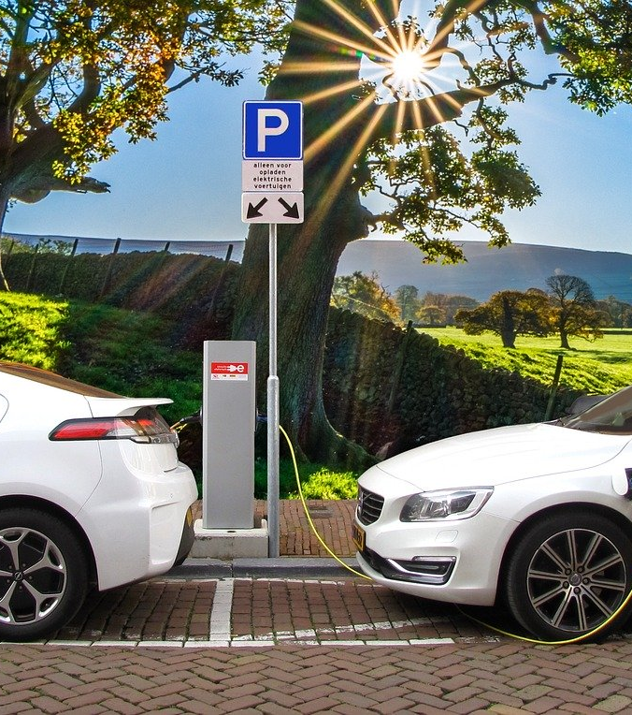
02
Key Takeaways
02.2 Public Engagement - Stakeholders
Our commitment to public engagement aligns with the NEVI Plan's emphasis on involving stakeholders in shaping our state's EV future. The Interagency Working Group has actively engaged with stakeholders through initiatives like the South Carolina Electric Vehicle Stakeholder Initiative, the Palmetto Clean Fuels Coalition. We have also harnessed online engagement tools successfully, such as our NEVI Program website and live-streamed Working Group meetings. Our aim is to ensure that decisions about the NEVI Formula Program consider public needs and preferences, fostering a collaborative approach for a sustainable EV ecosystem.

Slide 6
02
Key Takeaways
02.3 Contracting
Effective contracting and partnerships with private entities will be crucial to bolstering EV infrastructure and deployment initiatives. A continued commitment to 'Buy America' principles underscores the dedication to supporting domestic industries and ensuring the fair and equitable distribution of EV chargers and resources via an open competition process.

Slide 7
02
Key Takeaways
02.4 Electric Utility Providers
Electric utility providers play a critical role in the electrification of transportation. Their commitment to enhancing grid infrastructure, offering EV-friendly rate structures, and promoting clean energy sources directly impacts the success of EV adoption and sustainable mobility in South Carolina.
Dominion Energy
Duke Energy
Lockhart Power
Santee Cooper
Electric Cooperatives of SC
South Carolina Association of Municipal Power Systems (SCAMP)

Slide 8
02
02.4 Electric Utility Providers
Reliability in Uptime
Consistent uptime is crucial for the success of Direct Current Fast Chargers (DCFC), ensuring availability and reliability for users.
Charging Speed Considerations
DCFC stations should support charging speeds greater than 250 KW to be competitive and future-proof, allowing for quick charging times and the ability to upgrade as technology advances.
Utility and Siting Engagement
Early engagement with electric utilities during the siting process for DCFC is essential, considering transformer capacity, proximity to grid, and capacity, aiming for a first contact to in-service timeline of less than 6 months.
Supply Chain Management
It's important to anticipate long lead times for necessary components like 480 V 3 phase transformers and to maintain a utility stock of these transformers specifically for DCFC.

Slide 9
02
02.4 Electric Utility Providers
Site Amenities and Agreements
The availability of amenities (like restrooms, food, shopping, lighting, and security) and the resolution of site host agreements, including easement acquisition, land value use, and compensation, are among the biggest challenges.
Eliminating Non-viable Interchanges
Avoid sites along alternative fuel corridors that lack adequate amenities and to allow local electric utilities to perform a feasibility screen for viable interchanges.
Feasibility and Cost Efficiency
Encourage consideration of feasibility and cost efficiency rather than allowing power availability to be the sole factor in site selection.

Slide 10
02
Key Takeaways
02.5 Industry Association
Industry associations are vital partners in South Carolina's journey toward embracing sustainable EV transportation. They represent a wide range of sectors and interests contribute to the state's efforts in infrastructure development and policy advocacy.
South Carolina Convenience & Petroleum Marketers Association
South Carolina Lodging & Restaurant Association
South Carolina Trucking Association
South Carolina Council on Competitiveness
South Carolina Manufacturers Association
South Carolina Automotive Council
Conservation Voters of South Carolina
Sustain SC

Slide 11
02
02.5 Industry Association
Strategic Charger Placement
Place EV charging stations strategically along major highways and at halfway points between major cities to ensure coverage of major arteries in South Carolina.
Future-Proofing with NACS Plug and/or Standardized Plug
The NACS plug is advised to be added to charging station deployments to accommodate the majority of mainstream EV manufacturers as technology advances.
Support for Energy Providers and Equipment
Ensure energy providers can support the demand in the area and that charging equipment maintenance is accounted for, highlighting the need for fast charging capabilities.
Leveraging Private Funding
There is an interest in seeing how private entities like can leverage private funding for electrification, suggesting a collaborative approach between public initiatives and private investments.

Slide 12
02
02.5 Industry Association
Accessibility and Equity
Accessibility to low-income neighborhoods and to users with disabilities to avoid creating barriers that could result in exclusion from the benefits of EV infrastructure.
Funding
Expand access to funding to assist with implementation of EV chargers.
Solar/Battery Assistance
Explore feasibility of utilizing solar and/or battery storage to supplement the grid.
Large Wheel-Base Vehicles
While not the target for NEVI, consider features that will support occasional usage.
Evaluate Routes Other Than the Interstates
Expand to include non-interstate locations, such as evacuation corridors, disadvantaged neighborhoods, or tourist destinations.

Slide 13
02
02.5 Industry Association
Branding
Consistent signage and pavement markings
Coordination with Local Entities
Listen intently and clearly communicate the goals, objectives.
Charging Costs
Price fluctuations and peak demand charges.
Grid
Ensure the grid can support these improvements. Implement strategies to offset demand on the grid in coordination with electric utility providers.

Slide 14
02
Key Takeaways
02.6 Academia
Academic institutions in South Carolina have played a pivotal role in advancing EV technology and supporting the growth of the EV industry. Their contributions span education, research, and workforce development.
The EVWG met with: South Carolina Technical College System Clemson University Trident Technical College University of South Carolina – Department of Chemical Engineering

Slide 15
02
02.6 Academia
South Carolina Technical College System
Technical colleges are actively training and preparing students for careers in the EV industry, ensuring a skilled workforce to meet the growing demand for EV-related jobs.
Clemson University
Clemson University's CU-ICAR serves as a leading center for EV research and resources, contributing to the advancement of EV technology and infrastructure.
Trident Technical College
Trident Technical College's REVVED program and initiatives provide education and training opportunities that support the development of EV education.
University of South Carolina – Department of Chemical Engineering
The University of South Carolina is at the forefront of EV battery research, contributing to the development of more efficient and affordable EVs through cutting-edge research in battery technology.

Slide 16
02
Key Takeaways
02.7 Equity Considerations
Equity considerations play a crucial role in South Carolina's approach to EV adoption. The Interagency Working Group is committed to aligning with the Justice40 initiative by recognizing the importance of EV charging infrastructure along major transportation corridors to improve the lives of disadvantaged groups by increasing transportation options and promoting job growth.

Slide 17
02
Key Takeaways
02.8 Labor and Workforce Considerations
Ensuring the safe installation and maintenance of EV chargers by a qualified and diverse workforce is a priority. The Interagency Working Group, with its diverse membership, is actively engaged in discussions regarding labor and workforce issues. South Carolina's technical college system, including programs like readySC and Apprenticeship Carolina, stands as a valuable resource for building a competitive and diverse workforce to support the growth of EV infrastructure in the state. Utilize and build upon the South Carolina Department of Employment and Workforce’s Report: Evaluation and Analysis of the Electric Vehicle Workforce in South Carolina

Slide 18
02
02.8 Labor and Workforce Considerations
Rapid Growth
The EV ecosystem is expanding rapidly, which necessitates a parallel growth in the workforce to support industries such as vehicle and battery manufacturing, charging infrastructure, and auto repair/maintenance.
Demand Outpacing Supply
There is a noted discrepancy between the demand and supply of the workforce in key occupations within the EV ecosystem, which is expected to widen as the industry grows.
Diverse Workforce Strategies
Strategies to build the EV workforce should target multiple populations, including efforts to reduce barriers to labor participation, highlighting the need for inclusivity in workforce development​.

Slide 19
02
02.8 Labor and Workforce Considerations
Workforce Development Recommendations
Increase awareness of EV occupations to attract more talent •
Develop clear and comprehensive career pathways and tools •
Promote work-based learning opportunities for hands-on experience •
Expand reentry programs for reintegrating ex-offenders •
Invest in upskill programs and support services (transportation and child care) •
Regional Coordination Goals
Develop a core competency inventory for EV-related occupations •
Establish a consistent narrative for EV jobs •
Review and harmonize policies across states to facilitate resource access •

Slide 20

02
02.8 Labor and Workforce Considerations
By the numbers
SUPPLY GAP
WORKFORCE SHORTAGES
2,693
473
839
Total Supply Gap between educational programs and job market demands
Supply Gap for Industrial Engineers
Supply Gap for Software Developers
Source:
SC Department of Employment and Workforce

Slide 21
02
Key Takeaways
02.9 Cybersecurity & Communications
To address cybersecurity concerns, the Interagency Working Group recognizes the importance of contract specifications for robust cybersecurity provisions to be incorporated into EV charging stations. The need for access to broadband capabilities is recognized as a fundamental requirement to support not only EV charging infrastructure but also to enable secure data communication and analytics. Protecting against cyber threats is essential for safeguarding payment system hosts, energy providers, and customers.

Slide 22

03
Consultant assistance with the nevi formula program
SCDOT has entered into a partnership with HDR as the NEVI Program Assistant

Slide 23

04
Recap of plan vision & goals
South Carolina’s plan will prioritize placement of passenger car electric vehicle (EV) charging equipment
along the interstate highway system to complement completion of the national network. Initial emphasis
will be placed on rural sections of interstate where the lack of urban facilities make it less feasible for
investments from the private sector. Public outreach and stakeholder engagement will occur to identify
fair, equitable, and contextually appropriate locations for the equipment

Slide 24
05
Moving forward into 2024
Identify supportive policies
Identify funding opportunities
EO

Slide 25
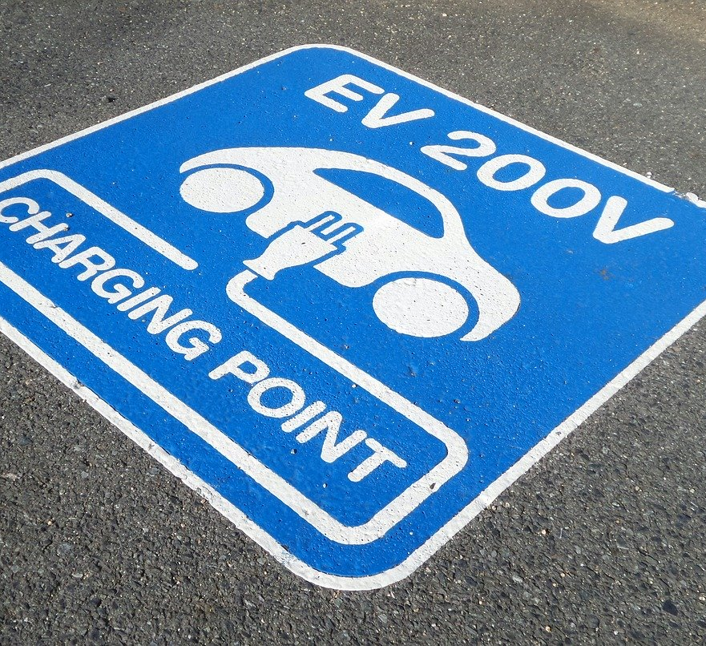
Contacts &
Reference links
Justin Powell, Chief Operating Officer and EVWG Chairman
powelljp@scdot.org
Rob Bedenbaugh, Director of Engineering Support and NEVI Lead
bedenbaugr@scdot.org
SCDOT NEVI Formula Program
Executive Order 2022-31

Slide 26
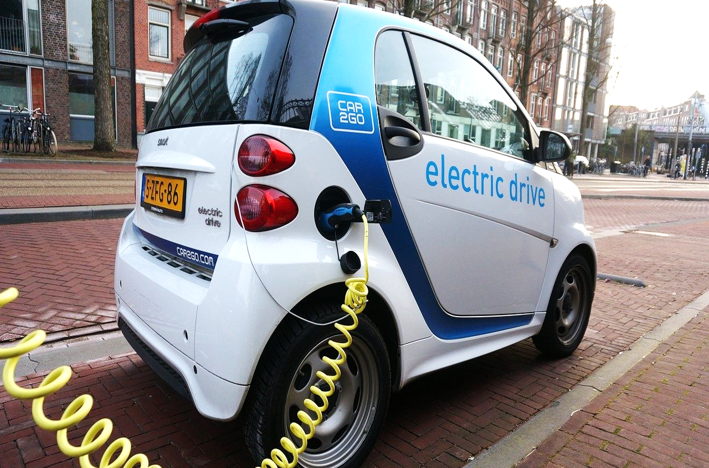
Thank you

